Slide 1
Crimson Clubs (Design)
Adam Gabriel, Travis Redfield, Taylor Meads,
Maclane May, Max Livingston

Slide 2
Recap
Manage clubs and teams
Receive push notifications to your phone
View calendar of events

Slide 3
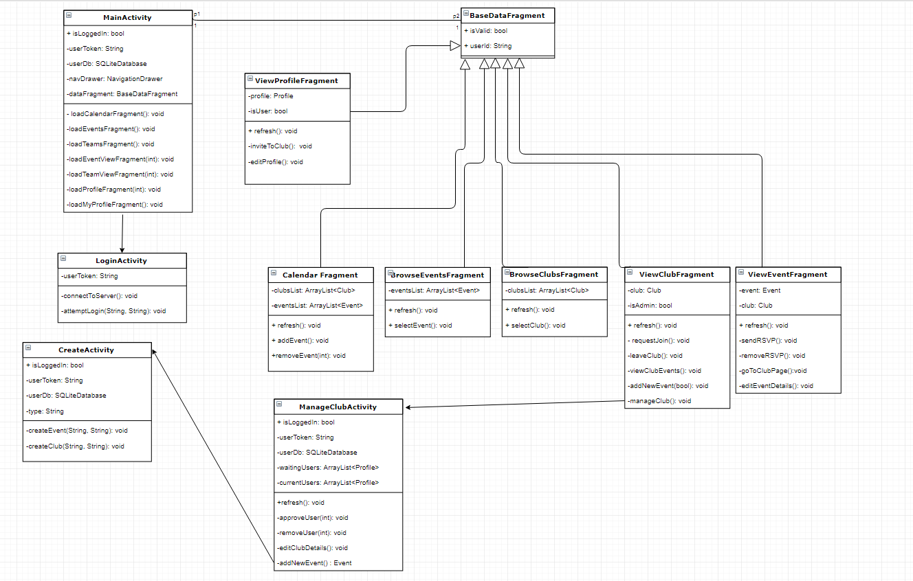
Class Diagram

Slide 4
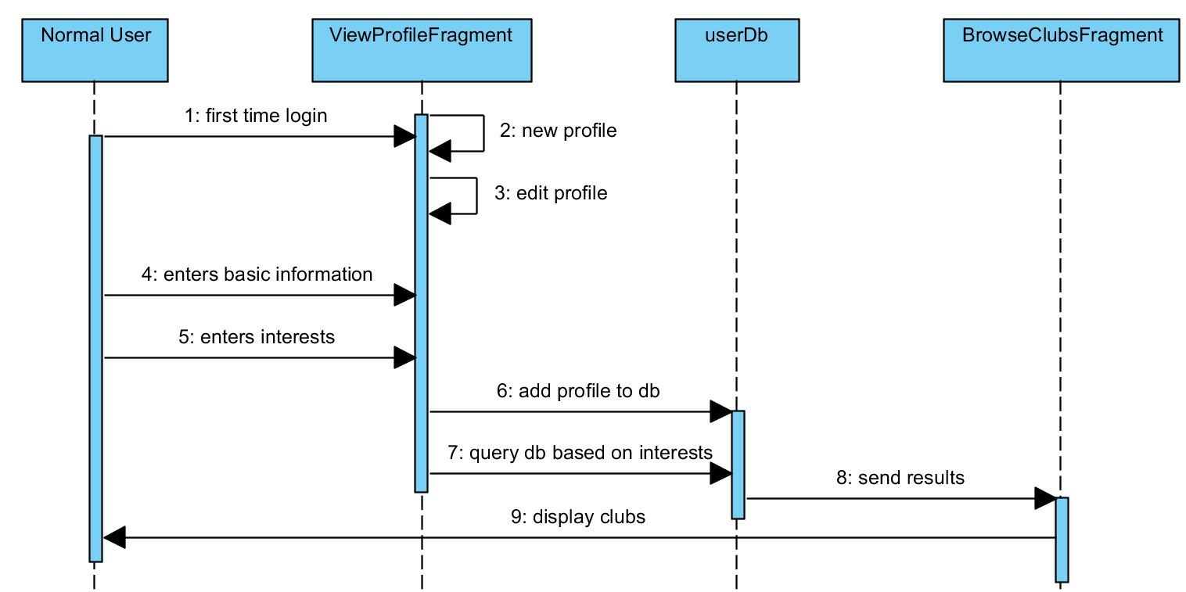
Create Profile

Slide 5
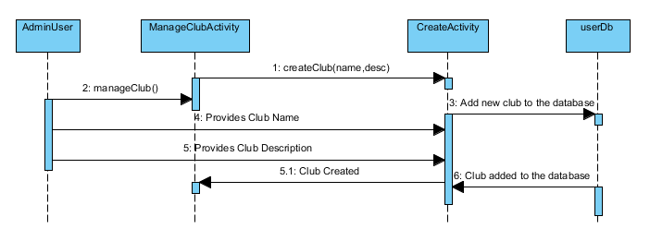
Create Club

Slide 6
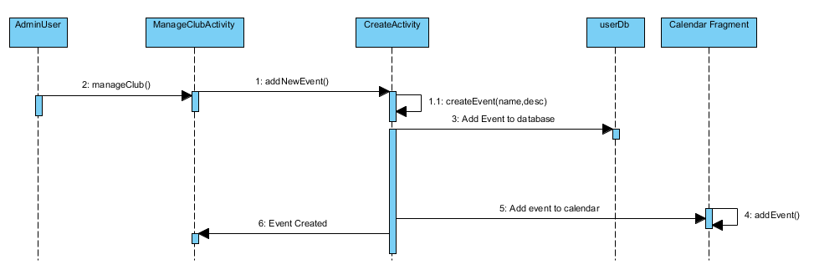
Create Event

Slide 7
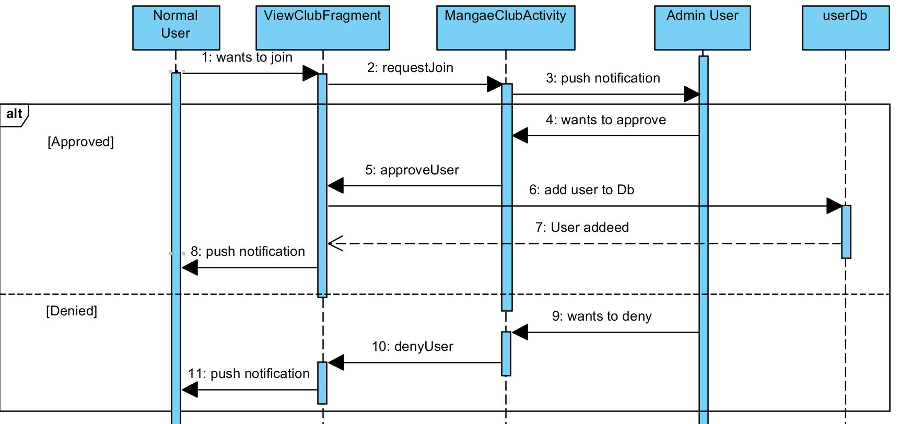
Join Club

Slide 8
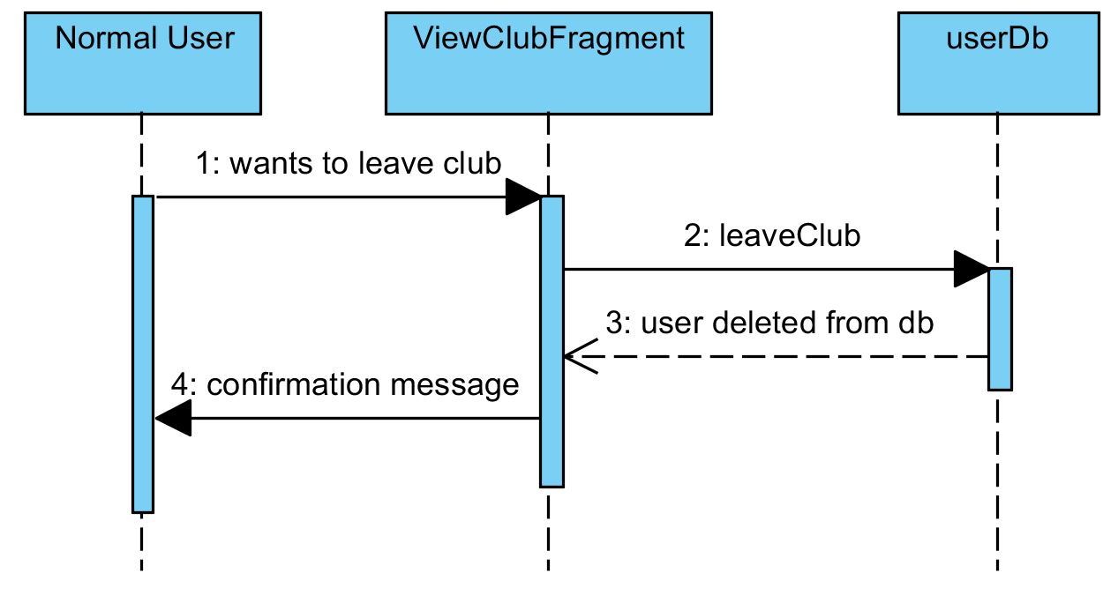
Leave Club

Slide 9
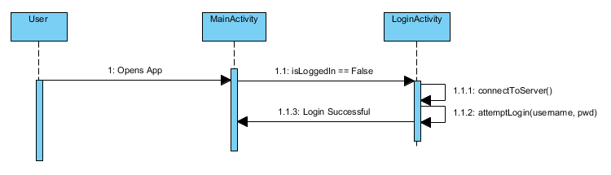
Login Activity

Slide 10
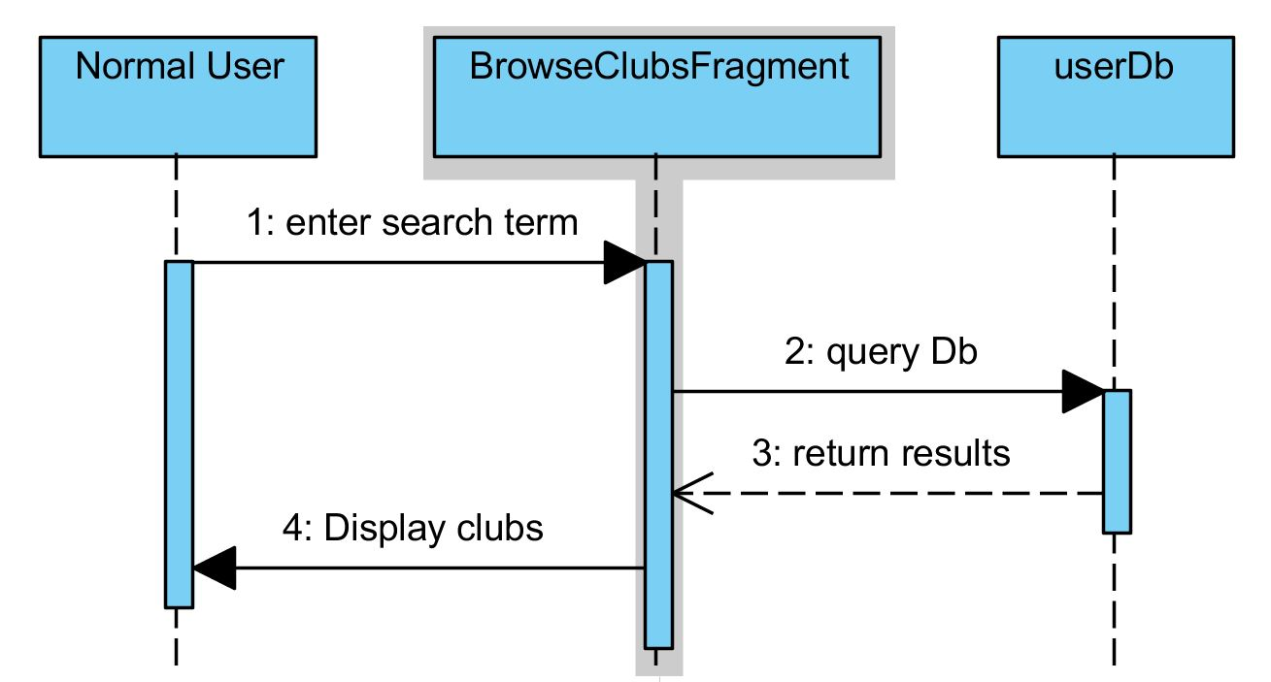
Search Clubs

Slide 11
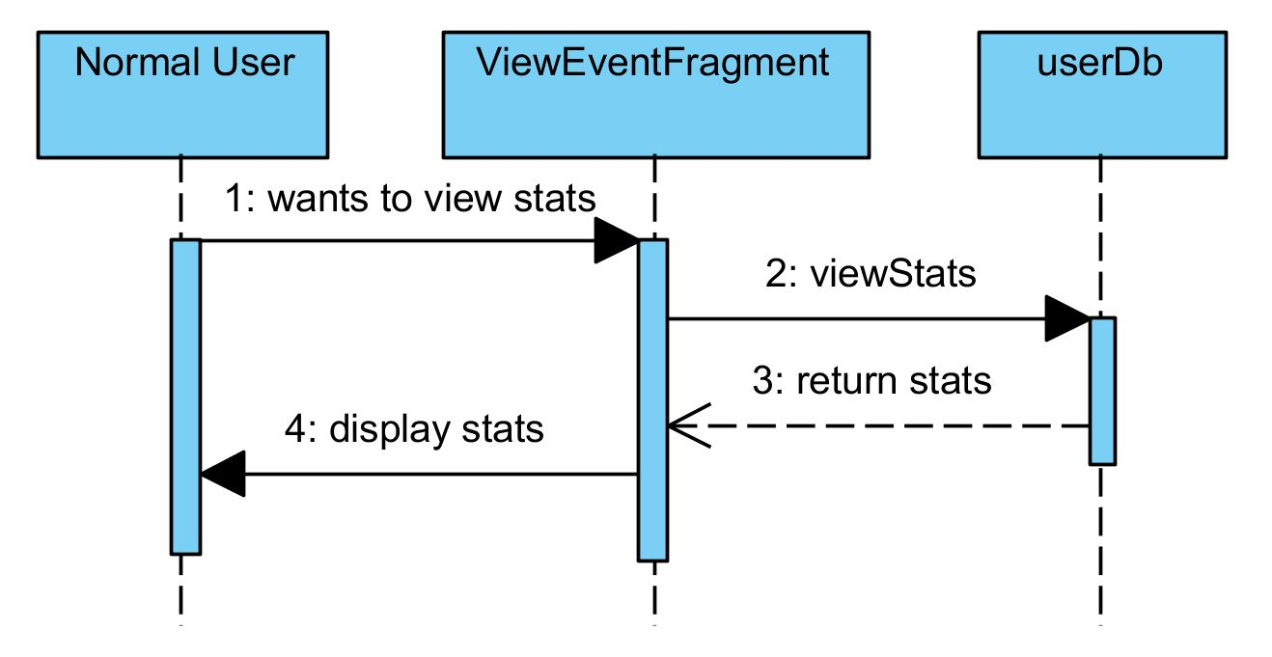
View Event Statistics

Slide 12
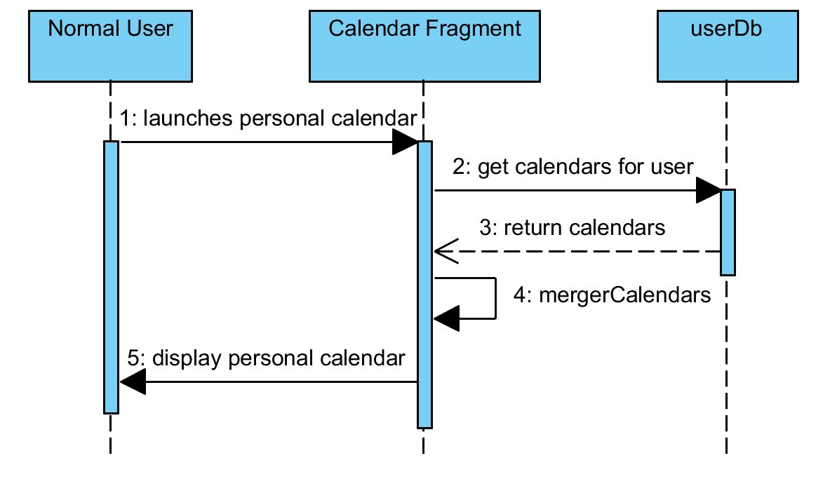
View Calendar

Slide 13
Project Changes
No major project changes
Shifting focus
Database
Stored procedures
Web calls
Front end

Slide 14
Summary
Good Progress
Everything is going has planned

